Slide 1

about_VideoProcessing
Thorsten Butz

Slide 2

Many thanks to our sponsors:

Slide 3


about_Session
{
"Title" : "about_VideoProcessing",
"Speaker" : "Thorsten Butz",
"Uri" : "thorsten-butz.de",
"Twitter" : "@thorstenbutz",
"Podcast" : "slidingwindows.de"
}

Slide 4
Previously on PSConfEu

Slide 5
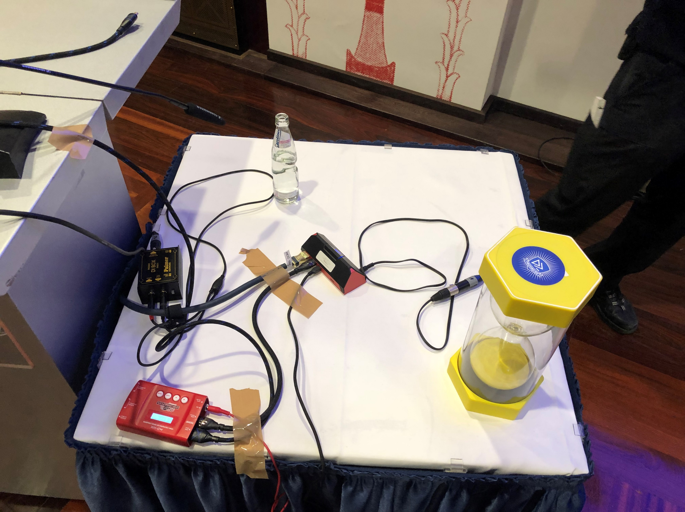

Slide 6
Toolbox

Slide 7




Tools & Services
Free Software
Open Broadcaster Software (OBS)
FMPEG
Camtasia
auphonic.com

Slide 8
ffmpeg.exe -h
Hyper fast Audio and Video encoder
usage: ffmpeg [options] [[infile options] -i infile]... {[outfile options] outfile}...
Getting help:
-h -- print basic options
-h long -- print more options
-h full -- print all options (including all format and codec specific options, very long)
-h type=name -- print all options for the named decoder/encoder/demuxer/muxer/filter/bsf/protocol
See man ffmpeg for detailed description of the options.
Print help / information / capabilities:
-L show license
-h topic show help
-? topic show help
-help topic show help
--help topic show help
-version show version
-buildconf show build configuration
-formats show available formats
-muxers show available muxers
-demuxers show available demuxers
-devices show available devices
-codecs show available codecs
-decoders show available decoders
-encoders show available encoders
-bsfs show available bit stream filters
-protocols show available protocols
-filters show available filters
-pix_fmts show available pixel formats
-layouts show standard channel layouts
-sample_fmts show available audio sample formats
-dispositions show available stream dispositions
-colors show available color names
-sources device list sources of the input device
-sinks device list sinks of the output device
-hwaccels show available HW acceleration methods
Global options (affect whole program instead of just one file):
-loglevel loglevel set logging level
-v loglevel set logging level
-report generate a report
-max_alloc bytes set maximum size of a single allocated block
-y overwrite output files
-n never overwrite output files
-ignore_unknown Ignore unknown stream types
-filter_threads number of non-complex filter threads
-filter_complex_threads number of threads for -filter_complex
-stats print progress report during encoding
-max_error_rate maximum error rate ratio of decoding errors (0.0: no errors, 1.0: 100% errors) above which ffmpeg returns an error instead of success.
-vol volume change audio volume (256=normal)
Per-file main options:
-f fmt force format
-c codec codec name
-codec codec codec name
-pre preset preset name
-map_metadata outfile[,metadata]:infile[,metadata] set metadata information of outfile from infile
-t duration record or transcode "duration" seconds of audio/video
-to time_stop record or transcode stop time
-fs limit_size set the limit file size in bytes
-ss time_off set the start time offset
-sseof time_off set the start time offset relative to EOF
-seek_timestamp enable/disable seeking by timestamp with -ss
-timestamp time set the recording timestamp ('now' to set the current time)
-metadata string=string add metadata
-program title=string:st=number... add program with specified streams
-target type specify target file type ("vcd", "svcd", "dvd", "dv" or "dv50" with optional prefixes "pal-", "ntsc-" or "film-")
-apad audio pad
-frames number set the number of frames to output
-filter filter_graph set stream filtergraph
-filter_script filename read stream filtergraph description from a file
-reinit_filter reinit filtergraph on input parameter changes
-discard discard
-disposition disposition
Video options:
-vframes number set the number of video frames to output
-r rate set frame rate (Hz value, fraction or abbreviation)
-fpsmax rate set max frame rate (Hz value, fraction or abbreviation)
-s size set frame size (WxH or abbreviation)
-aspect aspect set aspect ratio (4:3, 16:9 or 1.3333, 1.7777)
-vn disable video
-vcodec codec force video codec ('copy' to copy stream)
-timecode hh:mm:ss[:;.]ff set initial TimeCode value.
-pass n select the pass number (1 to 3)
-vf filter_graph set video filters
-ab bitrate audio bitrate (please use -b:a)
-b bitrate video bitrate (please use -b:v)
-dn disable data
Audio options:
-aframes number set the number of audio frames to output
-aq quality set audio quality (codec-specific)
-ar rate set audio sampling rate (in Hz)
-ac channels set number of audio channels
-an disable audio
-acodec codec force audio codec ('copy' to copy stream)
-vol volume change audio volume (256=normal)
-af filter_graph set audio filters
Subtitle options:
-s size set frame size (WxH or abbreviation)
-sn disable subtitle
-scodec codec force subtitle codec ('copy' to copy stream)
-stag fourcc/tag force subtitle tag/fourcc
-fix_sub_duration fix subtitles duration
-canvas_size size set canvas size (WxH or abbreviation)
-spre preset set the subtitle options to the indicated preset
Black magic

Slide 9
Basic encoding

Slide 10
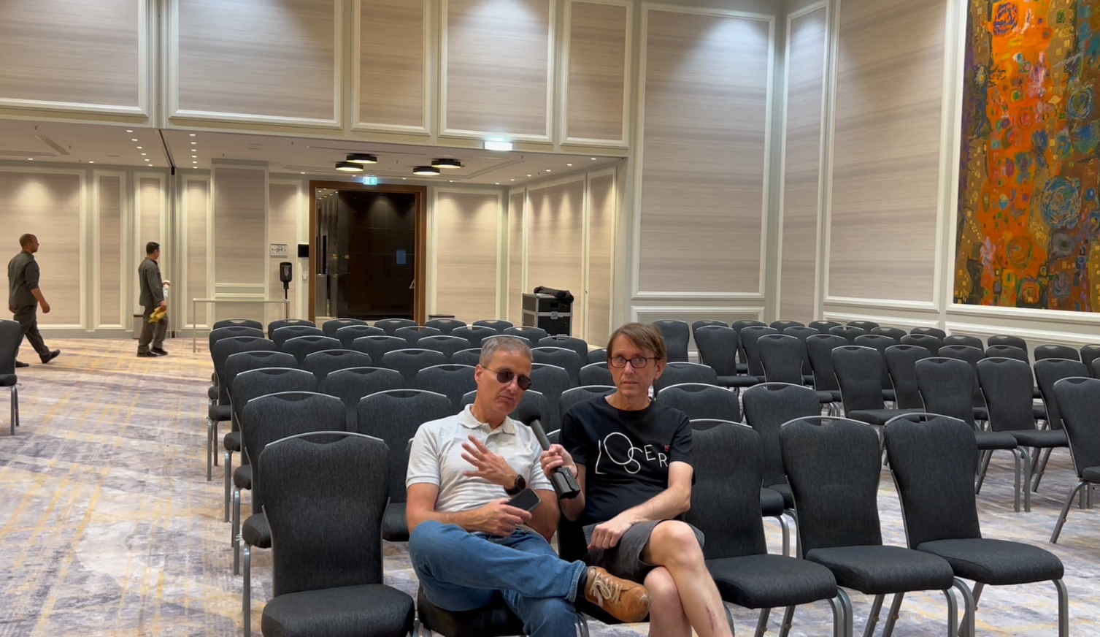
An interview with Tobias Weltner
Notes:
Demo videos used in this session
## Untouched video
https://vimeo.com/721974571/6ee5affca1
## Processed video (with Intro/Outro)
https://youtu.be/DlCCimHl0LM

Slide 11
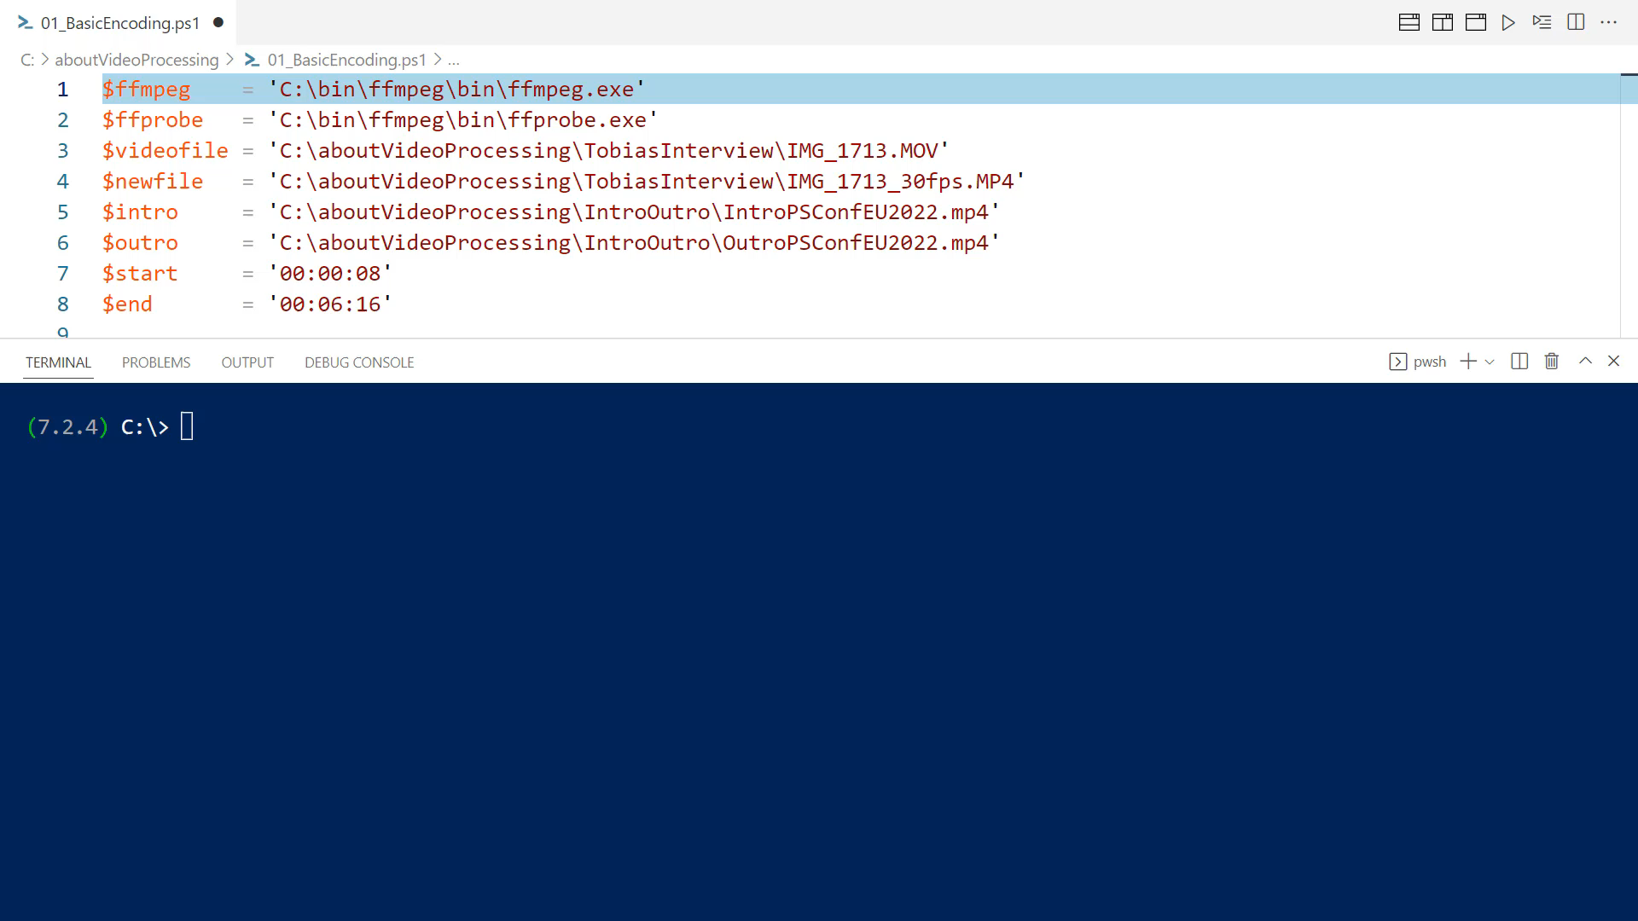

Slide 12
Little helpers
function Get-MP4Duration {
[CmdletBinding()]
param (
[Parameter(Mandatory,ValueFromPipeline,ValueFromPipelineByPropertyName)]
[ValidateScript({ Test-Path -Path $_ })]
[string] $File,
[switch] $asTimeSpanObject
)
process {
[System.IO.FileSystemInfo ] $file = Get-Item -Path $file
$shellObj = New-Object -ComObject Shell.Application
$folderObj = $shellObj.Namespace("$($file.Directory)")
$fileObj = $folderObj.ParseName("$($file.Name)")
$duration = $folderObj.GetDetailsOf($fileObj, 27)
## Create a TimeSpan object
$durationArray = $duration.Split(':')
if ($asTimeSpanObject) {
New-TimeSpan -Hours $durationArray[0] -Minutes $durationArray[1] -Seconds $durationArray[2] } else { $duration }
}
}

Slide 13
Publishing

Slide 14
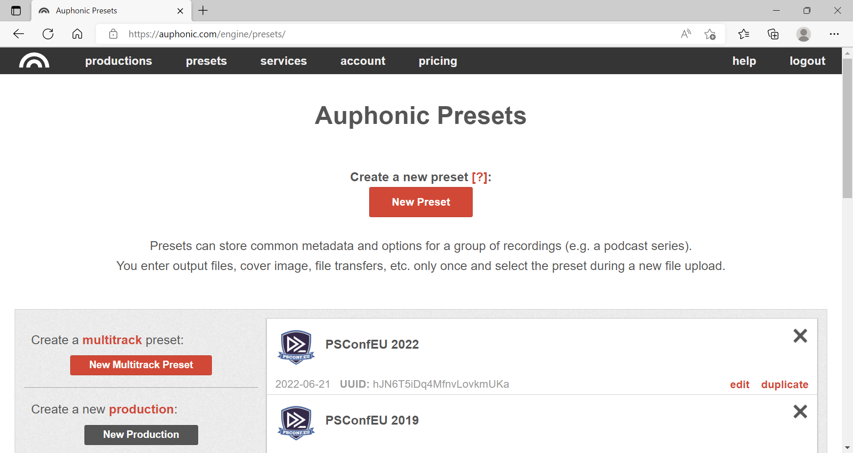

Slide 15
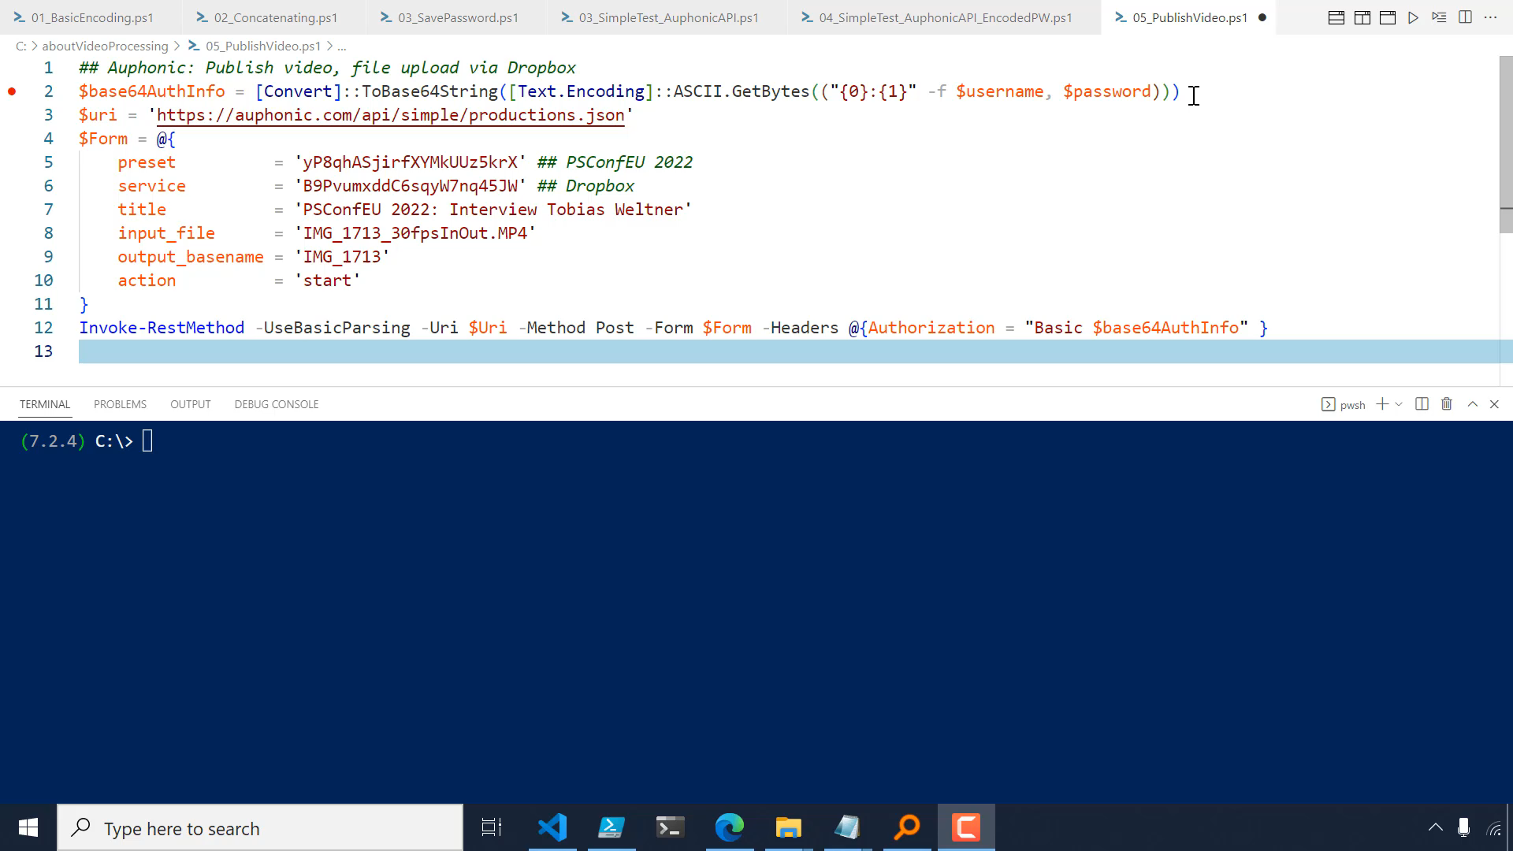

Slide 16
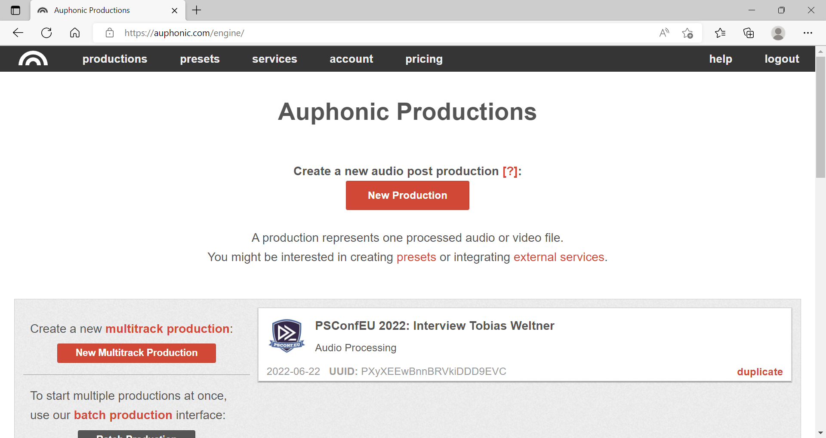

Slide 17
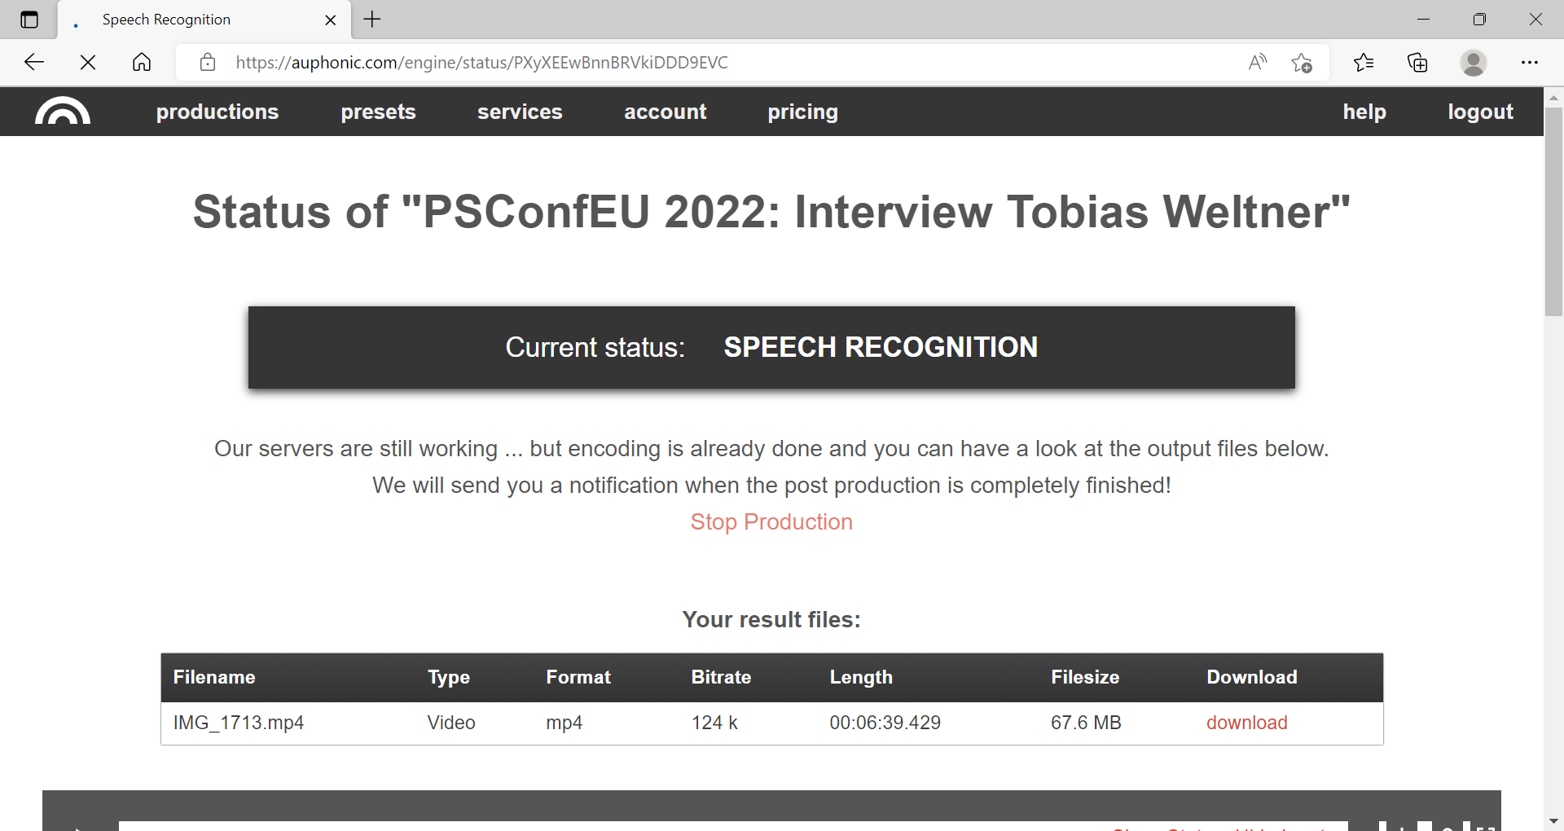

Slide 18
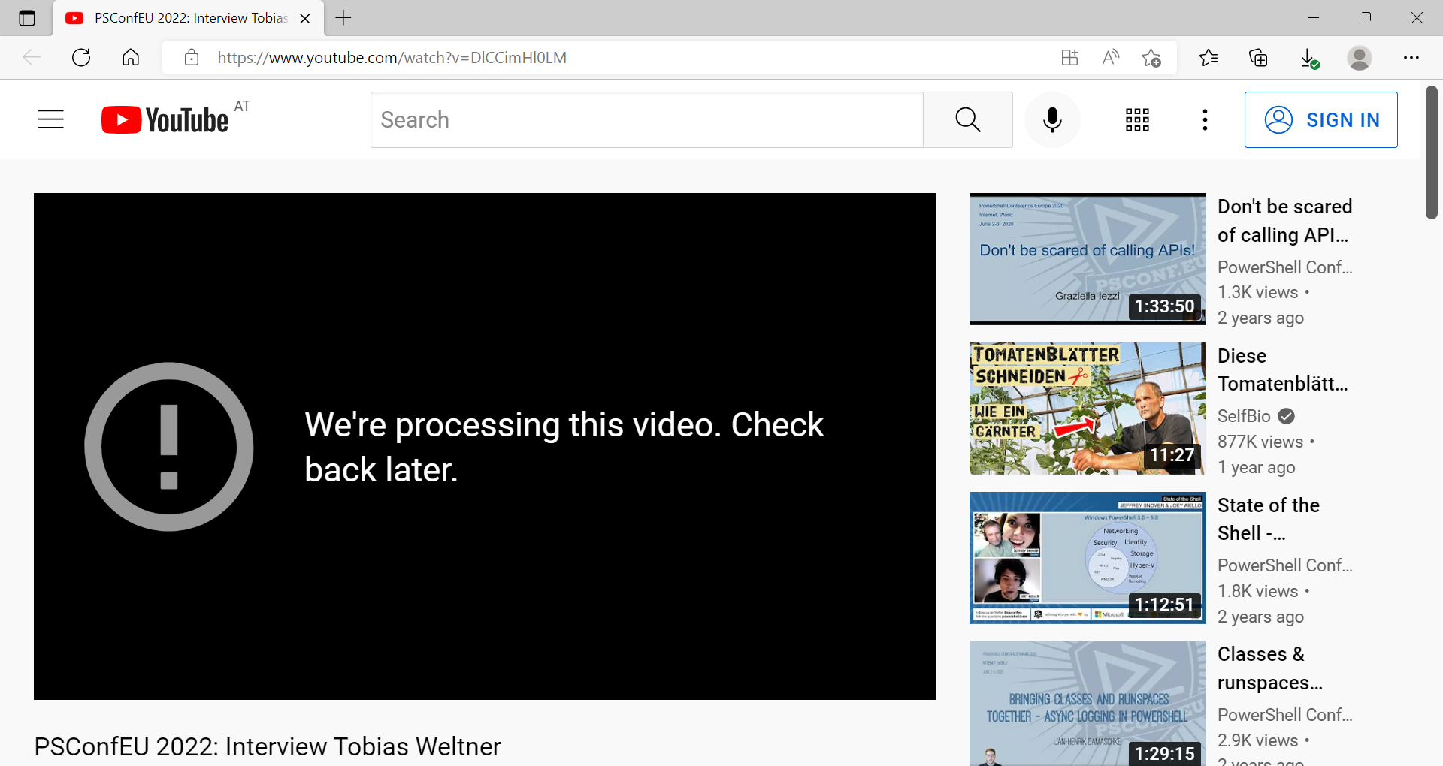

Slide 19
Finally
Youtube
Local file

Slide 20
Thank you for listening!
{
"Title" : "about_VideoProcessing",
"Speaker" : "Thorsten Butz",
"Uri" : "thorsten-butz.de",
"Twitter" : "@thorstenbutz",
"Podcast" : "slidingwindows.de"
}

